Slide 1
November 19, 2015

Slide 2
AGENDA - Steve
Welcome - Steven Glyer
CIO/DSN Meeting
CPT Leadership/CTE Innovation Grant
Nick Kremer
DOW
Skills Builder
Strategic Planning Committee
Board of Governor's - Taskforce on Workforce, Jobs and a Strong Economy
Program Inventory - Lori Sanchez
LA SB1070 - Counselor Event - Lyla Eddington
CCCAOE - Kari Irwin
Chancellor’s Report - Robin Harrington
CTE EF - Best Practice - Bruce Noble

Slide 3
Chief Instructional Officer/
Deputy Sector Navigator Summit - Steve
January 22, 2016
All 27 CIOs
All 14 DSNs
Long Beach City College
Purpose
Each group to understand the roles of the other
How to engage to DSN to support the college
Open dialog between both groups

Slide 4
California Career Pathways Trust (CCPT) Leadership Summit - Steve
CCPT Leadership Summit - Sacramento Nov. 9-10
Jobs for the Future (JFF) - Technical Assistance Providers (TAPs)
LA-OC CPT Leadership Summit - Friday, April 1, 2016 - LA County Office of Education, Downey

Slide 5
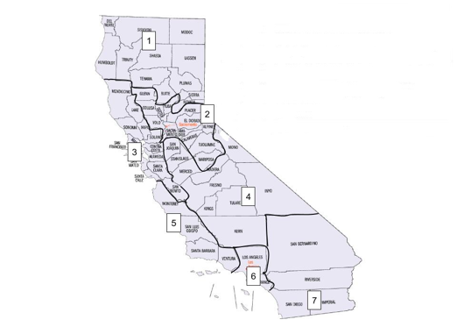
CTE Incentive Grant
Yr. 1 - $400,000,000
Yr. 2 - $300,000,000
Yr. 3 - $200,000,000
K12 Districts
Charter Schools
County Office of Ed
ROPs

Slide 6
Board of Governors Task Force on Workforce Update
Taskforce on Workforce, Job Creation and a Strong Economy 25 recommendations were approved on Monday, Nov. 16, 2015.
Brice Harris stated that the implementation plan for the recommendations will be presented to the Board of Governors meeting in January.

Slide 7
Strategic Planning Committee Membership - Nick
The Committee asked to have DSN representation.
The DSNs convened and selected:
Ruth Cossio-Muniz - Retail, Hospitality & Tourism - Orange County
Jannet Malig - Adv Trans/Renewables - Los Angeles
Shari Hertzfeld - Health (LA) - Alternate

Slide 8
Decision Processes and Organizational Structure Workgroup

Slide 9
The DOW
Decision Processes and Organizational Structure Workgroup

Slide 10
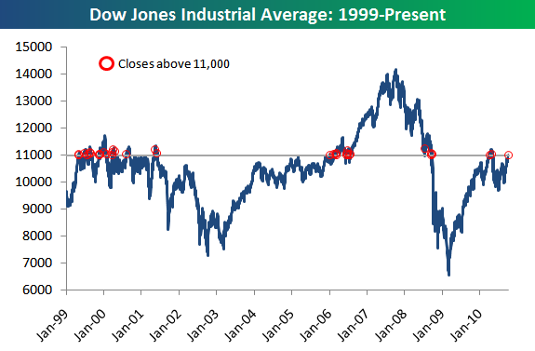
The DOW

Slide 11
The DHOW

Slide 12
Members
Consortia Membership
Alicia Berhow - OCBC
Laura Cantu - LA SB1070
Alex Davis - LACC
Salomon Davila - PCC
Paul De La Cerda - ELAC
Lyla Eddington - Ring SB1070
Bart Hoffman - Santa Ana
Bruce Noble - Rio Hondo/DSN
Jan Swinton - Glendale
Tony Teng - Saddleback
LAOCRC Leadership
Steven Glyer
Nick Kremer
Lori Sanchez
Janeth Manjarrez

Slide 13
Purpose
How do we make decisions as a region?
What is the best organizational structure?
How do we respond to the recommendations for regionalization in the Strong Workforce Report ?

Slide 14
Process
DOW
Implementation
Consortium
CEO, CIO, Faculty Review
SPC
DOW
DOW
SPC

Slide 15
Discussion to Date
Identify decisions that need to be made at the regional level
Program endorsement
Priority sectors
Distribution of funds channeled through the region

Slide 16
Facilitation Role
Coordination with internal groups (CIOs, academic senate, etc)
Facilitate alignment with work of external groups (WIBs, economic development organizations, etc)
Coordinate the DWM assets and talent (COE, DSN,TAPs)
Marketing of colleges and programs
Provide channels for communication between the colleges
Facilitate partnerships between the colleges
Coordinate professional development

Slide 17
Decision Making
Establish a formal process
Empower an executive committee
CEO, CIO, Consortium, faculty
Identify which decisions executive committee makes and which the consortium voting members make
(Note: Adoption of the Strong Workforce recommendations may expand this list)

Slide 18
Organizational Options
Current combined region with tweaks
Separation with autonomy for each county
Hybrid
Provide county autonomy on some activities
Such as work with external partners, professional development
Carry out other activities on a combined region basis
Such as Coordination of assets, program approval

Slide 19
Going Forward
Inclusion
Input
Transparency
Agendas and meeting summaries posted on LAOCRC site in Strategic Planning Committee (SPC) section.

Slide 20
Scorecard Career Skills-Builder
Student Metric

Slide 21
Student Course Taking Pattern
Students completes at least one course (.5 units). Some number of these units must be a SAM A, B, or C course (higher level CTE)
No longer enrolled after 1 year
Did subsequently not earn an award or transfer to a four-year institution
Did not fail a CTE course during the academic year
Wages in both time points (1 year before & 1 year after cohort year)

Slide 22
Threshold for units: 0.5
Research showed that many skills-builders take only one course. But how low should the unit threshold be?
Analysis of student records showed that in some disciplines, there were a significant number of students taking fewer than 3 units:
24,336 students took between 0.5 and 3 units, 85% of whom enrolled in public and protective services courses.
Students who took between 0.5 and 3 units in public and protective services had earnings gains of $7,219.

Slide 23
Statewide: 92,841
Typical campus: 500 to 1000
Wage gain: 15% (median gain $4,431)

Slide 24
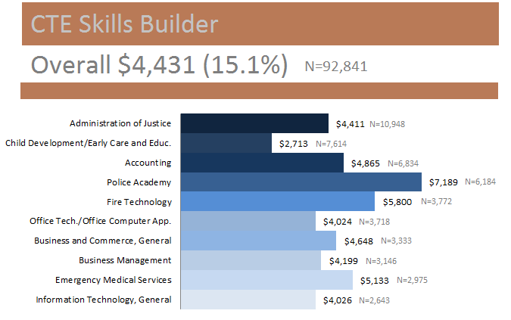
Data Display

Slide 25
How many skills-builders are there, compared to completers?
Sector | Skills-Builders | Completers
Public Safety & Protective Services | 23,964 | 8,185
Small Business | 19,426 | 18,731
ICT/ Digital Media | 13,362 | 6,803
Health | 9,237 | 16,179
Advanced Manufacturing & Advanced Technology | 8,656 | 5,429
Retail/Hospitality/Tourism | 4,631 | 5,410
Ag, Water & Environmental Technologies | 3,127 | 2,203
Advanced Transportation & Renewable Energy | 2,555 | 4,222
Energy (Efficiency) & Utilities | 813 | 1,285
Global Trade & Logistics | 222 | 286
Life Sciences / Biotechnology | 158 | 217

Slide 26
Implications
Part of Scorecard 2015-16
Recognizes this segment of students
Explains what happens to some of our “dropouts”
Useful in program review

Slide 27
Program Inventory - Lori
24 of 27 colleges have responded - Finalizing
Purpose and Uses
Purpose
To have an easily accessible, accurate database of all
CTE programs and awards in the region
Uses
Supply to the region
Collaboration
Suggested additions
Catalog description of program
Related occupations
Links to college websites
Include non-CTE programs

Slide 28
LACCD/RING SB1070 - Lyla
Counselor Workshop November 5th for LA Ring College HS Partners and colleges.
December 2, LA CCD and LA Ring Colleges finalization of Policies and Procedures for Articulation (CBE), Dual Enrollment, & Development of Career Pathways. Implementation Strategies will also be discussed.

Slide 29
California Community Colleges Association for Occupational Education Update - Kari
What’s Happening?...
CCCAOE Director Position- Closes Dec. 18
CTE Curriculum Academy in partnership with ASCCC- Jan. 14-15 in Napa, Apply by Dec. 15
LA/OC CCCAOE Deep Dive Roundtable- Jan. 21 after LAOCRC meeting

Slide 30
California Community Colleges Association for Occupational Education Update - Kari
EDGAR/PERKINS Workshop by Michael Brustein- Mar. 10 Santa Monica or Mar.11 Riverside
CCCAOE, ASCCC, CCCCIO, CSSO Special Joint Conference- April 20-22, Sacramento
CTE/EWD Leadership Academy-Summer 2016
More information: www.cccaoe.org
Email : Irwin_Kari@sccollege.edu

Slide 31
Chancellor’s Report
Perkins
Perkins V Reauthorization
ACTE Reauthorization Recommendations
http://www.acteonline.org/general.aspx?id=687#.Vj0fNXvTncs
Section 132 Certification Form
Quarterly Reporting
Managing Perkins Funds EDGAR (Michael Brustien)

Slide 32
Chancellor’s Report Continued
Apprenticeship
RFA 15-191 California Apprenticeship Initiative (CAI) New Innovative Grant Program
RFA 15-192 & 15-193 – Pre-Apprenticeship and Accelerator grants
RFA 15-194 The Outreach and Evaluation Grant
AB 86 Adult Education Consortium Program
Technical Assistance Webinars
http://aebg.cccco.edu/Events/AEBG-Webinar-Series

Slide 33
Chancellor’s Report Continued
WIOA
State Board Members: http://www.cwdb.ca.gov/wioa_member_roster.htm
WIOA Research Page: http://www.cwdb.ca.gov/workforce_innovation_opportunity_act.htm
WIOA Informational Meetings: http://www.cwdb.ca.gov/Default.htm
WIOA Approved Regional Planning Units
Simplicity
Practicality
Other

Slide 34
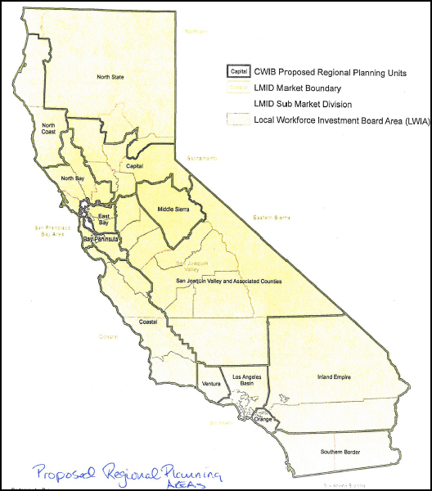
14 Regions

Slide 35
Chancellor’s Report Continued
Sector Navigator/Deputy Sector Navigator Renewals
Taskforce on Workforce, Job Creation and a Strong Economy
Focus over the next two years:
Student Success
Career Pathways
Workforce Data and Outcomes
Curriculum
CTE Faculty
Regional Coordination
Funding
http://doingwhatmatters.cccco.edu/Portals/6/docs/SW/BOG_TaskForce_Report_v12_web.pdf

Slide 36
More…………...
December Program Approval Cycle
Apps Due - Tuesday, Dec. 1, 2015
Voting Window - Dec. 8-15
PA Meeting - Dec. 17, 8:30 - 9:30
Consortia Meeting
Thursday, Dec. 17, 2015
10:00 - 11:00
Available Group Meetings
Thursday, Dec. 19, 2015
11:30 - 12:30

Slide 37
CTE ET - Best Practice
HVAC
Bruce Noble

